Slide 1
Center for Animal Health and Food Safety (CAHFS)
University of Minnesota College of Veterinary Medicine
Overview of CAHFS Research Projects and Activities
ARS Geospatial Environmental Epidemiology Workshop, May 2024
Rachel Schambow, DVM, PhD
Researcher, CAHFS
Prof. Andres Perez, DVM, PhD
Director, CAHFS Endowed Chair of Global Animal Health and Food Security

Slide 2
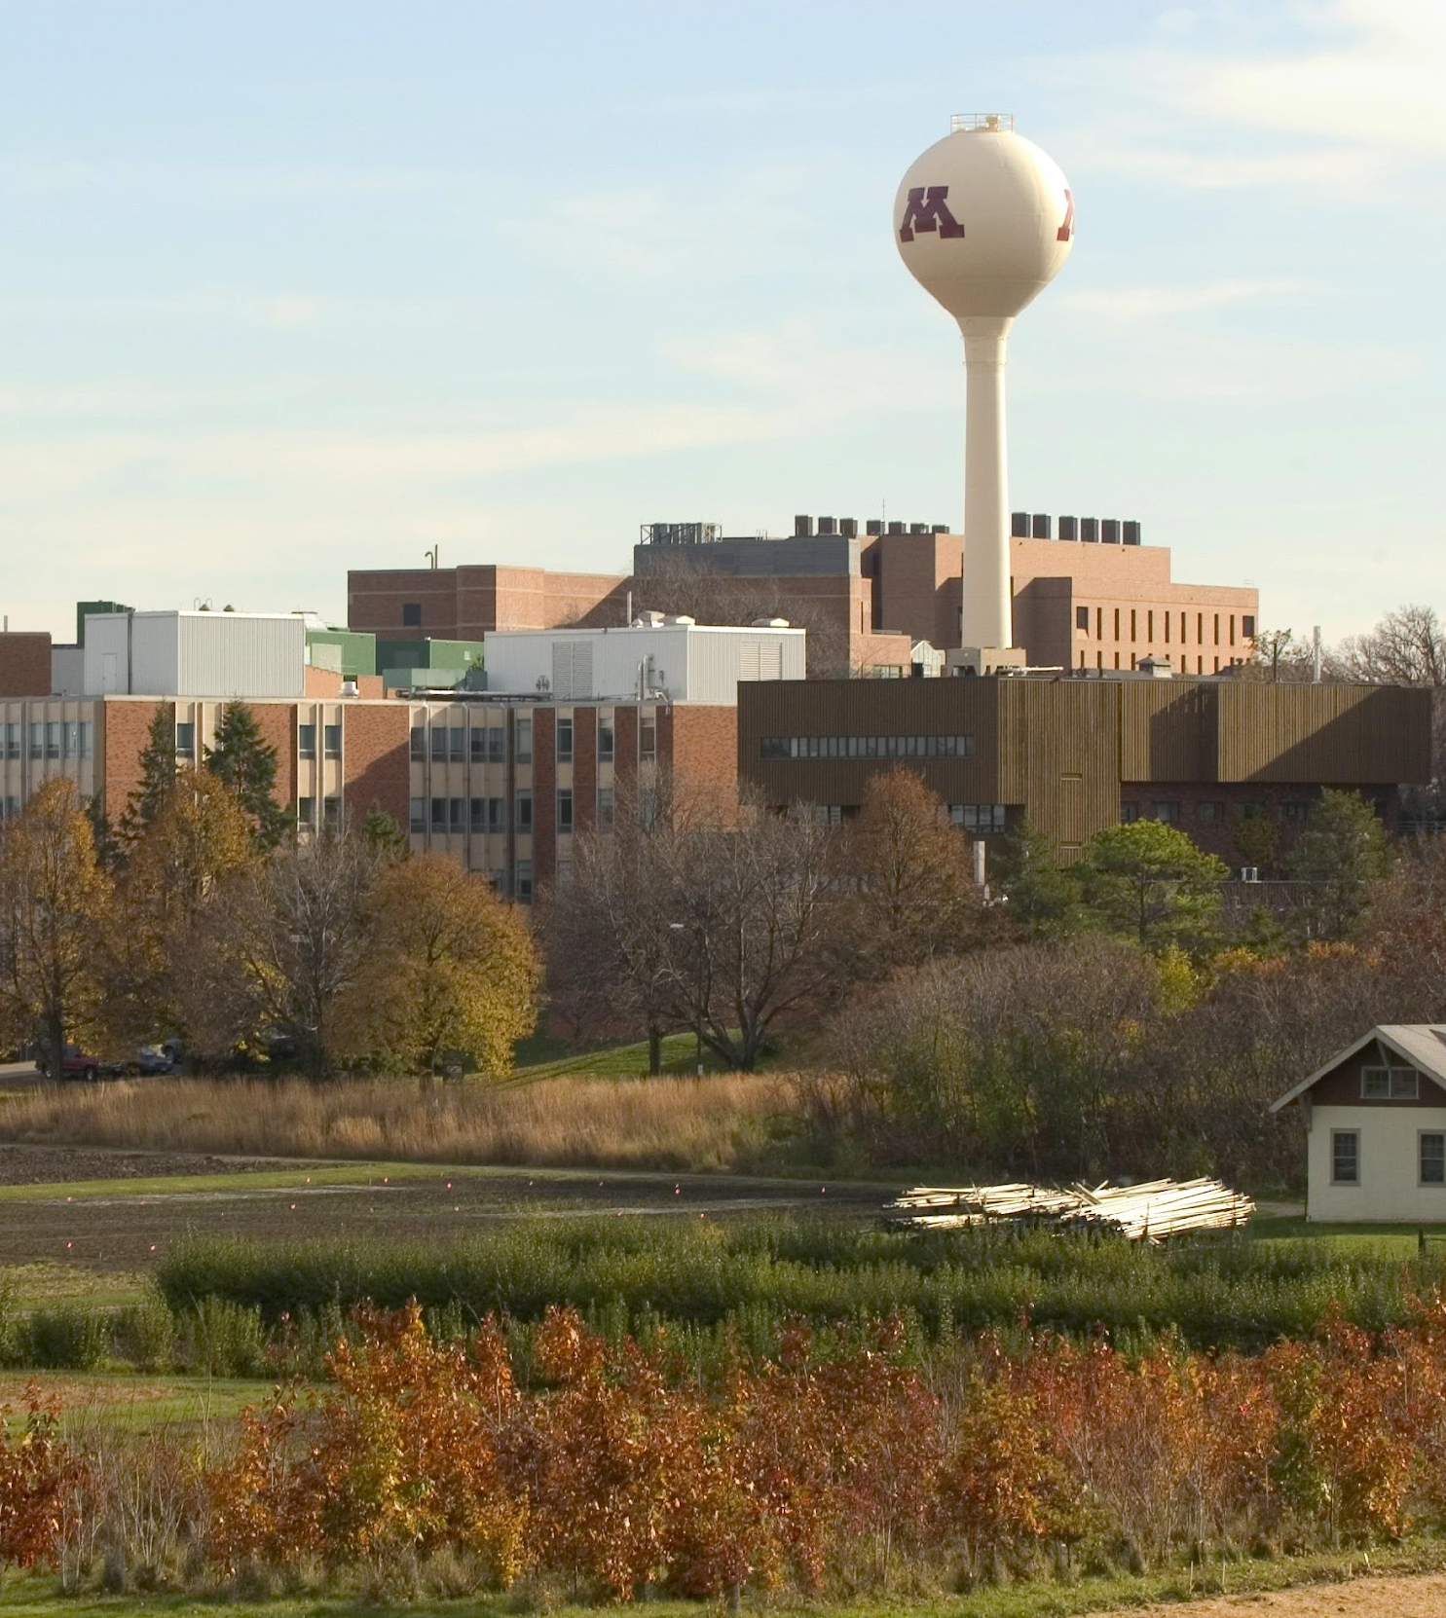
Outline
CAHFS
Foreign and Emerging Disease Research
African Swine Fever
Avian Influenza Dashboard
Japanese Encephalitis Virus, Vesicular Stomatitis Virus, Foot-and-mouth disease

Slide 3

Center for Animal Health and Food Safety (CAHFS)
CAHFS
Strategic Partnerships
Veterinary Public Health and Preventive Medicine Residency Program
Data Analysis
Education and Outreach
WOAH Collaborating Center
FAO Reference Center
Long standing (10+ years) relationship with USDA-ARS
Many collaborations with USDA-CEAH, USDA-APHIS, and USDA-FAS
Connecting Minnesota and the World to develop solutions
to shared challenges in veterinary public health

Slide 4
Foreign and Emerging Disease Research
African Swine Fever
Dominican Republic
Philippines
Vietnam
Caribbean
United States
Avian Influenza
Dashfluboard
Others
Foot-and-mouth disease
Japanese encephalitis virus
Vesicular stomatitis virus
Notes:
Point-of-care test evaluation (Multiple countries)
Caribbean: Vulnerability and risk assessment, research needs assessment
Vietnam and Philippines: Epidemiology and surveillance
DR: Control plan, veterinary accreditation, impact assessments (economic, mental health), transmission modeling, feed???
US: Surveillance, early detection, and sick pig program, risk assessment

Slide 5
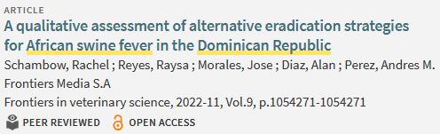
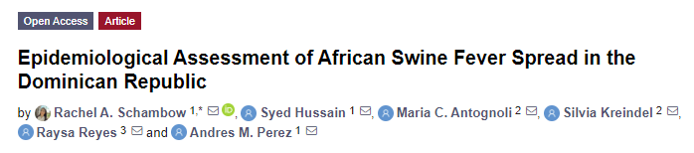
ASF Research in the Dominican Republic
Initial characterization of outbreaks through multiple site visits
Assessment of response strategies and spatiotemporal distribution of outbreaks using surveillance data
Continued partnerships with US and DR partners to build response capacity and reduce risk (USDA-APHIS, Silvia Kreindel)

Slide 6
ASF Research in the Dominican Republic
Project | Collaborators | Activities
Epi Assessment | USDA-APHIS (Silvia Kreindel) | Evaluate surveillance data and current situation
Progressive Control Plan | USDA-APHIS, DIGEGA, UASD | Develop plan to reduce ASF risk and impact over time through improvement of the swine industry and specific control strategies
Veterinary Accreditation | USDA-APHIS, DIGEGA, UASD | Educate cohort of veterinarians on ASF response capacity, including epi and control measures
Transmission Modeling | USDA-CEAH, UASD, field vets | Estimate transmission parameters by collecting outbreak data from farms
Impact Assessments | USDA-CEAH, UASD | Assess the economic and mental health impacts of ASF outbreaks
Point-of-care Test Assessment | USDA-APHIS | Assess the accuracy and fitness-for-purpose of selected point-of-care tests

Slide 7


ASF Research in the Caribbean and LATAM
Vulnerability assessment (USDA-APHIS, Silvia Kreindel)
New project to characterize the risk of introduction of ASF into the US from an ASF incursion in the region through assessment of 30+ countries
Propose mitigation measures to support USDA-APHIS decision-making
Collaborators from US and the region, including UC-Davis, CIRAD-CaribVet, Ross University, EpiX Analytics, OIRSA, and PorkColumbia
Research needs assessment (USDA-ARS, Jonathan Arzt)
Assess ASF research needs for LATAM region
Update from previous assessments (GARA / DR meetings)

Slide 8
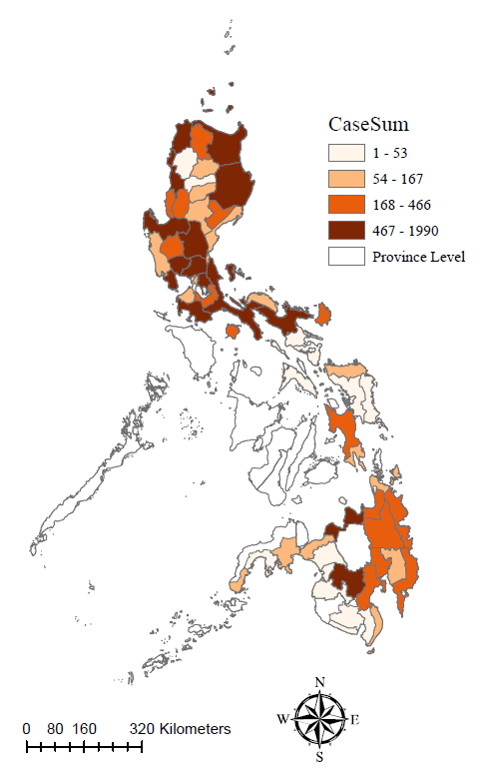
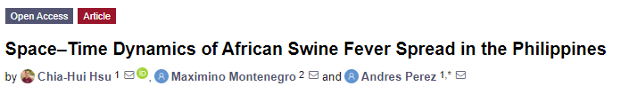
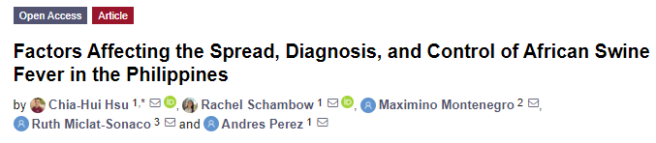
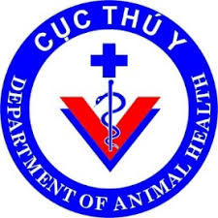

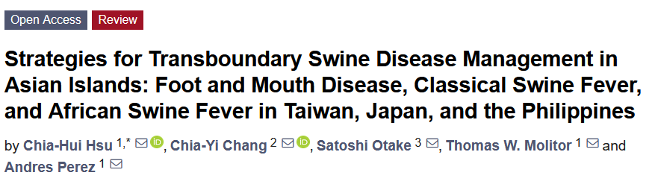
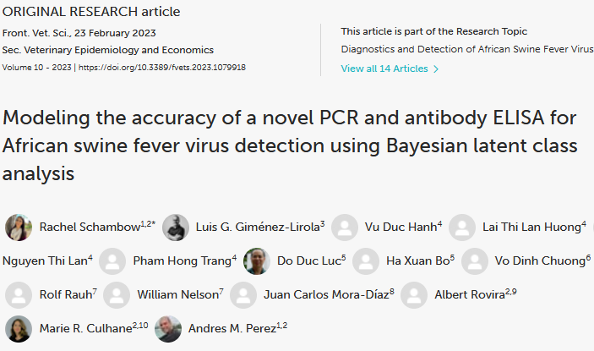





ASF Research in the Philippines and Vietnam
Epi and spatiotemporal assessment of ASF spread
Evaluation of risk factors

Slide 9
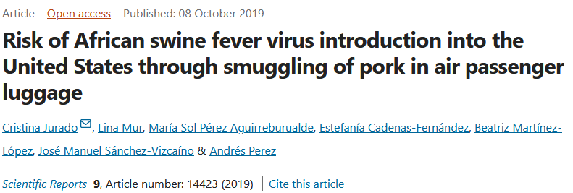
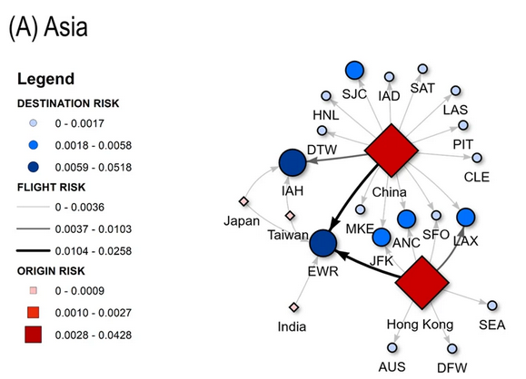
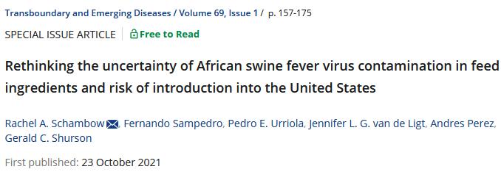
ASF Research in the United States

Slide 10
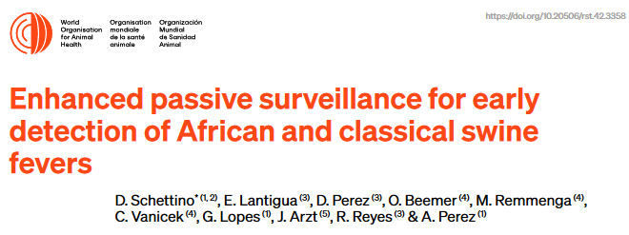
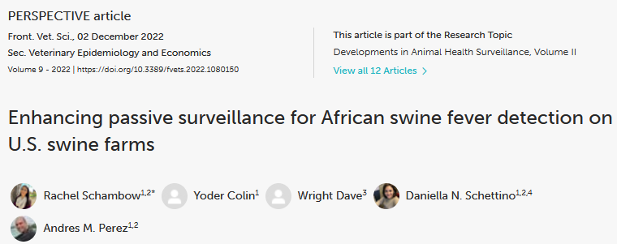
ASF Research in the United States
Cooperative agreement with USDA-CEAH (Cole Vanicek)
Evaluate ways to improve surveillance and early detection of FADs in the US
Recently, focusing on enhancements to the “Sick Pig Component” of the ASF/CSF Surveillance plan at veterinary diagnostic laboratories

Slide 11
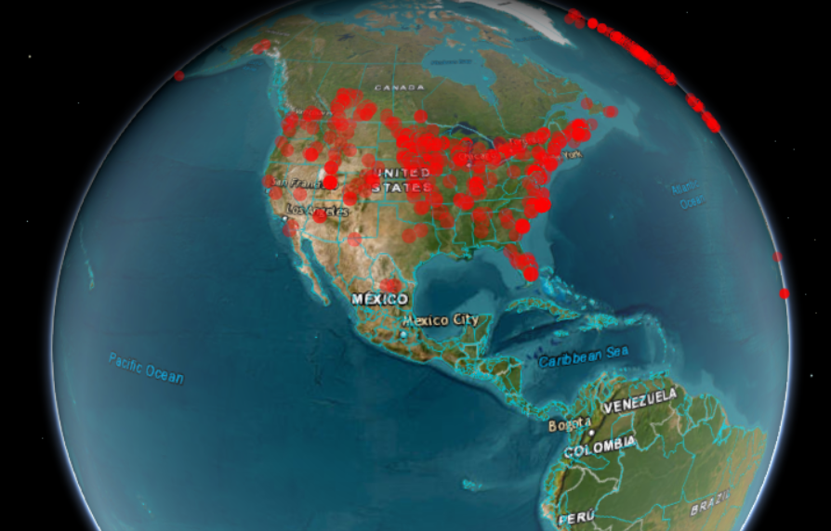
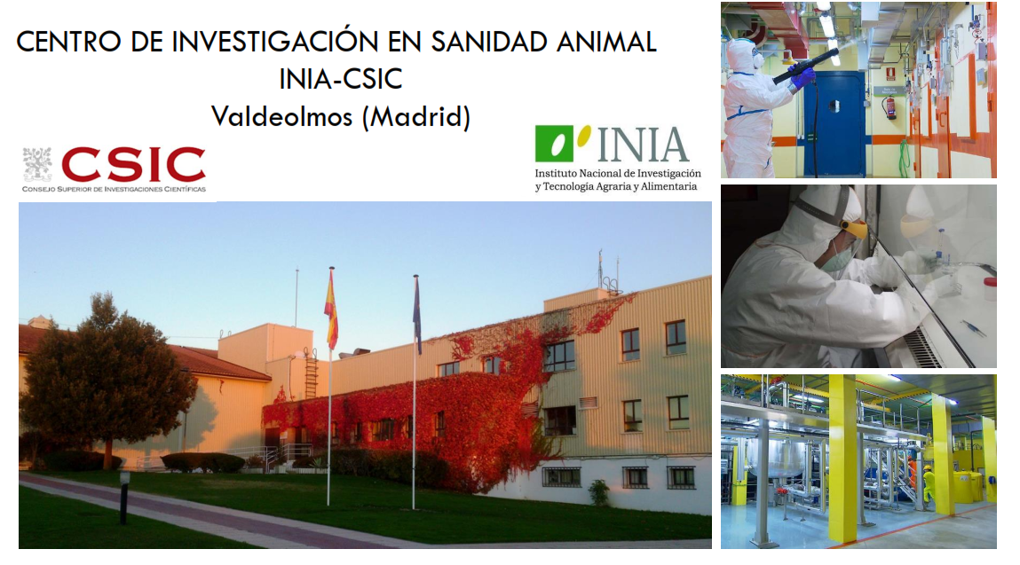
Detecting increase in risk for HPAI
Collaboration with INIA-CSIC, Spain
Dr. Irene Iglesias Martin. Epidemiology and Environmental Health Group of CISA (INIA-CSIC). iglesias@inia.csic.es
Notes:
But as we have see, Canada and the USA reported cases throughout the months of May, June, and July,…
..so in September, when the time of the migration of birds started
Born out of understanding and being aware of notifications in new areas
there's less information available on wild birds.
So, how can we bridge this gap?
In terms of tools we used spatial epidemiology to developed tools that allow us to monitoring outbreaks an wild birds movements at real time
which help address the challenge of monitoring the disease in wild birds, which is critical for understanding dynamics focus surveillance controlling focus and reduce consequences of the spread of avian influenza

Slide 12
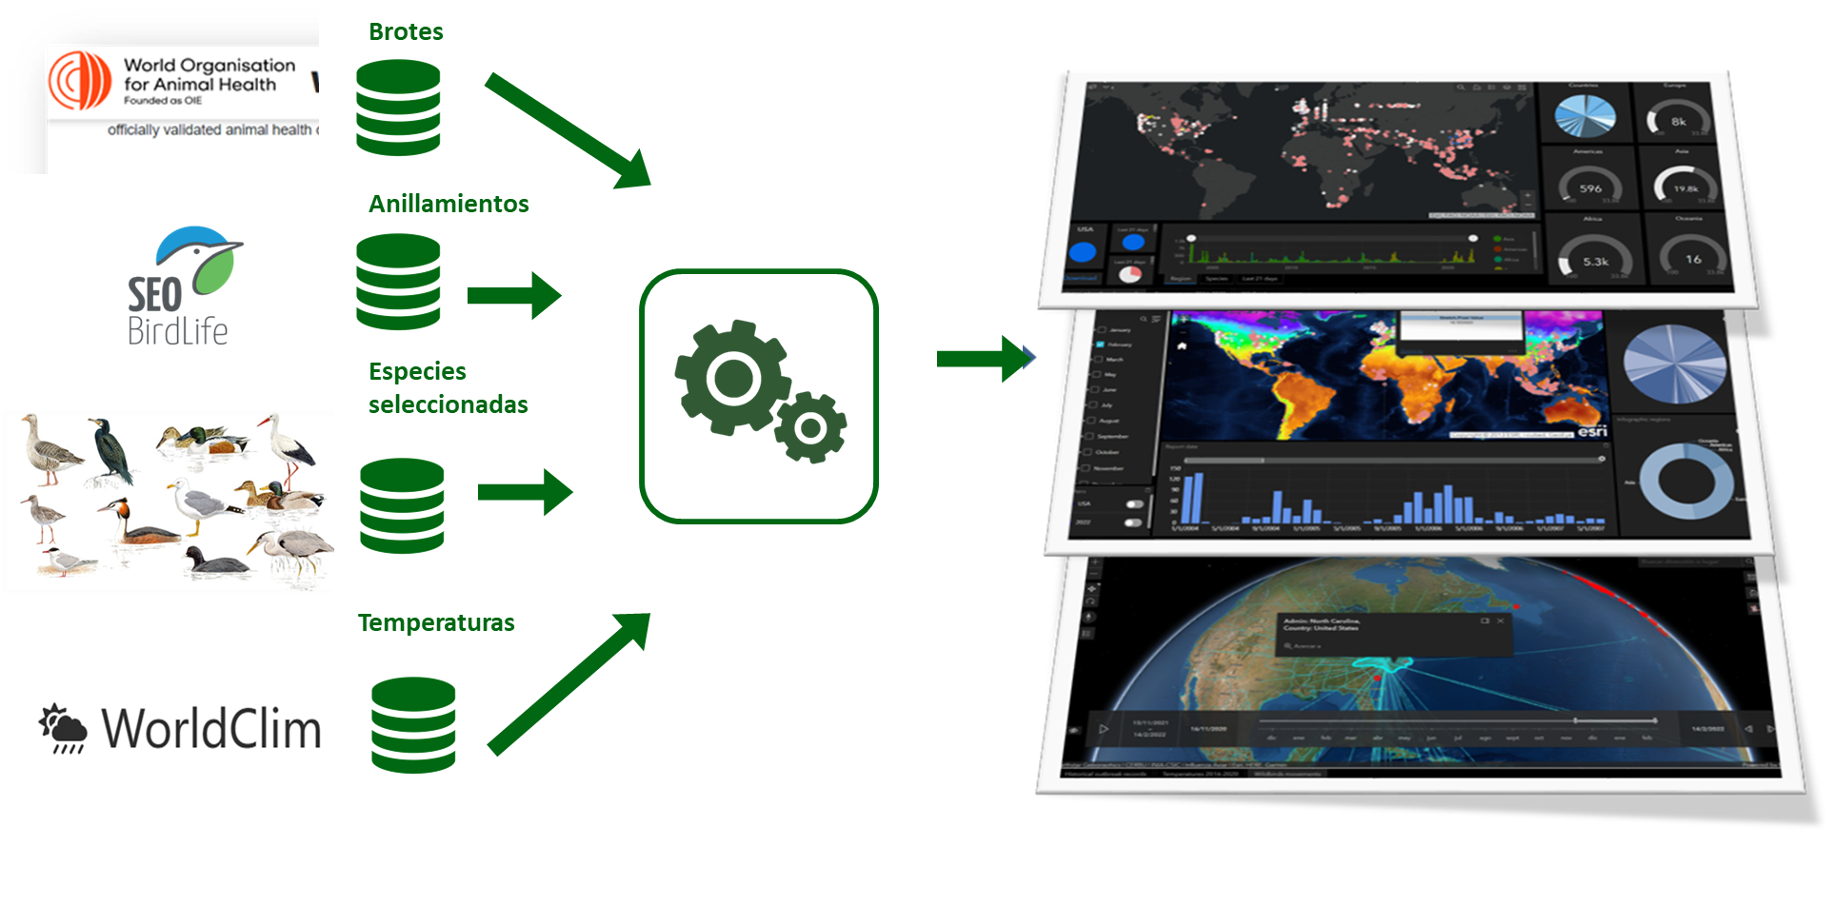

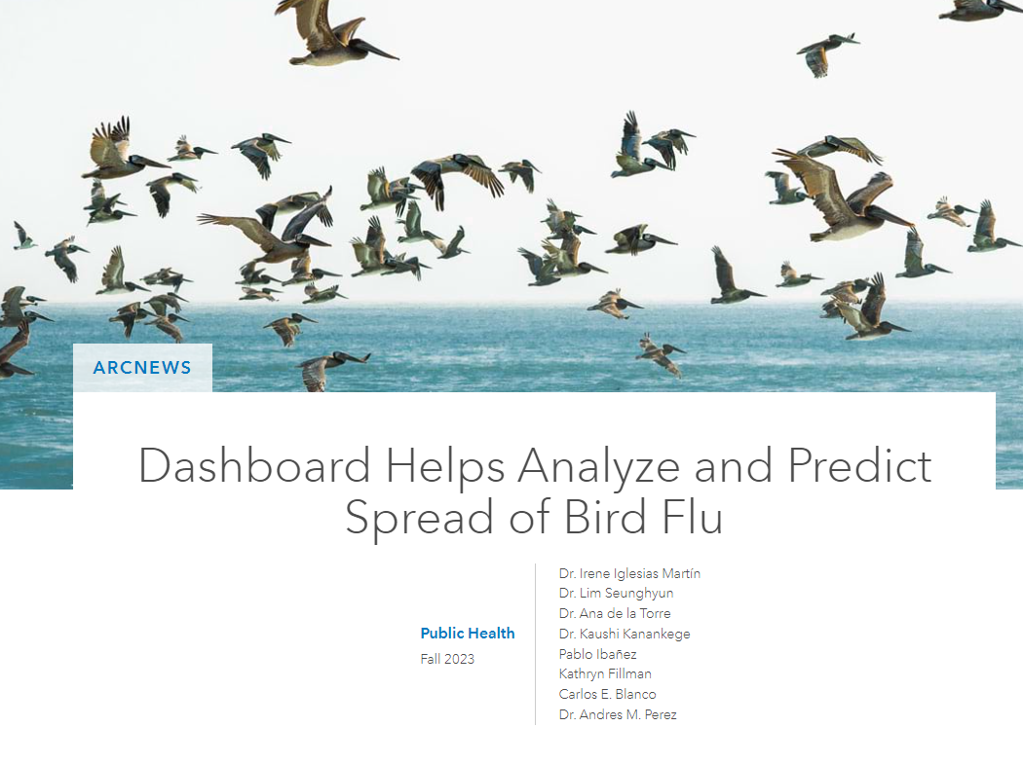
Exploring HPAI and Risk Factors: DashFLUboard
Real-time mapping exploration tool for the origin and status of avian influenza outbreak
https://cahfs.umn.edu/dashfluboard-avian-influenza-tracker
Notes:
We have developed two tools at real time:
one for Spain, DiFLUsion, a tool we designed and funded by the Ministry of Agriculture as an alert system for the introduction of highly pathogenic avian influenza into Spain,
and another, DashFLUboard, an exploratory tool for tracking the origins and outbreaks of avian flu in the Americas and in Europe .
Both tools The alert system created in Spain, called DlFLUsion, and the dashboard for North America share many similarities,
Both monitoring outbreks and wild bir movements.
Inputs: outbreaks from empresi, MOVEMENTS OF WATERBIRDS THROUGH usgs BIRD BANDING PROGRAM AND OTHERS, SELECT FOR RISK SPECIES, ADD WORLDCLIM TEMP DATA

Slide 13


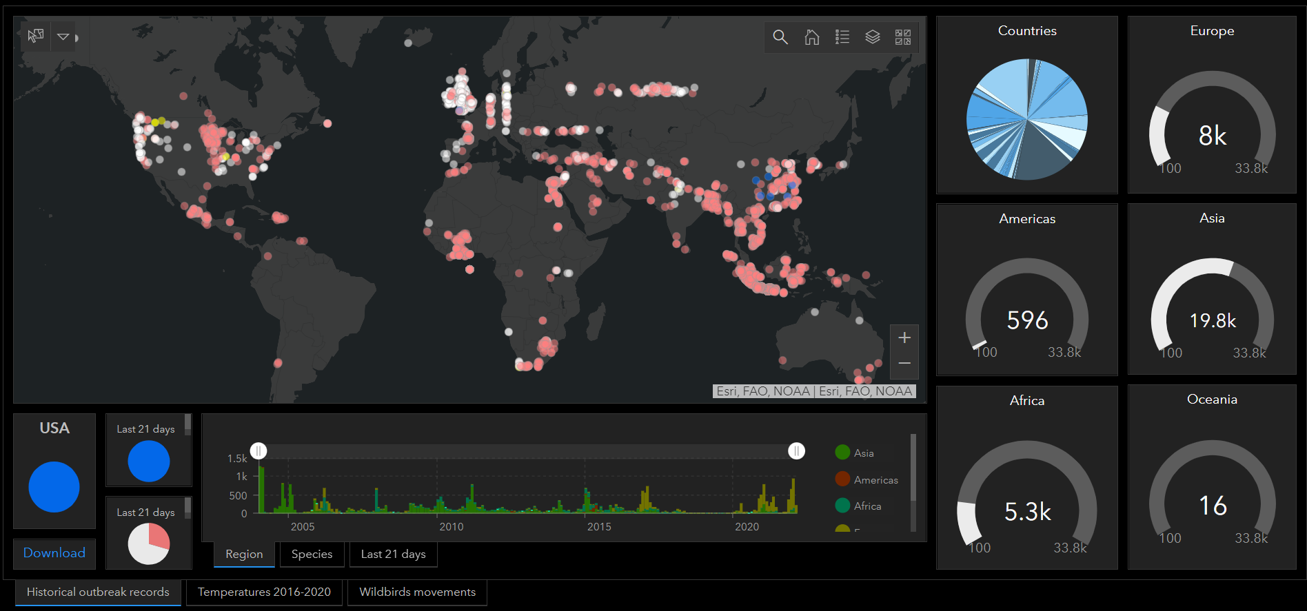
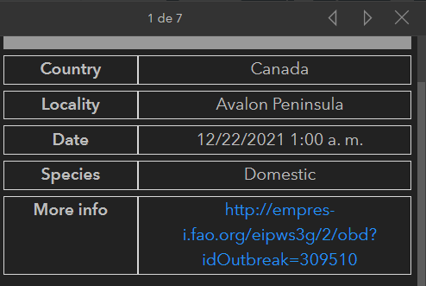
DashFLUboard: Real-time mapping exploring tools for origin and situation of avian influenza outbreaks
Notes:
Move on the dashboard. This is the application interface in the first screen .At the top, we can see a map of the outbreaks. The timeslider at the bottom allows you to select specific time periods by region or species. Graphs on the right interact with the selections and display information about the outbreaks that have been selected. Both,the timeslider or this tool above could be used to make a selection.
In all the displays when we click an outbreak we will see a POPup with outbreak info
The modular scheme of the DashFLUboard is really similar to the alert system in Spain. The idea is to include the same factors, and explore them together in a dashboard without the model:
Outbreaks are developing daily by web scraping to the Empress FAO website. we will change this data source when the woah api rest is ready
Movement data (based on ringing-recovering data) for 118 wild birds risk species were requested from the Bird Banding Laboratory (BBL) , close to 2 million data/registers. A network movement matrix was developed using ringing and recovery data. To facilitate exploration, the species were classified into nine taxonomic groups:
Selection criteria for risk species was based on species surveillance lists in the USA and the EU; and a compilation of wild bird aquatic species affected by HPAI based on OIE-FAO outbreaks notifications (since 2002-2020 ), EFSA data for passive surveillance (2005-2017) and positive wild bird species (H5, H7 or HP) in USA , Canada, and Greenland (2006-2018)
Monthly mean temperature maps source was WorldClime

Slide 14


Japanese Encephalitis Virus
Recently submitted a JEV proposal to characterize the vulnerability of US swine production (U of Sydney):
Analytical hierarchy process in ArcGIS to forecast vulnerable US areas
Produce vulnerability-based recommendations around surveillance and vector control, based on key risk factors for JEV transmission in Australia in 2022

Slide 15
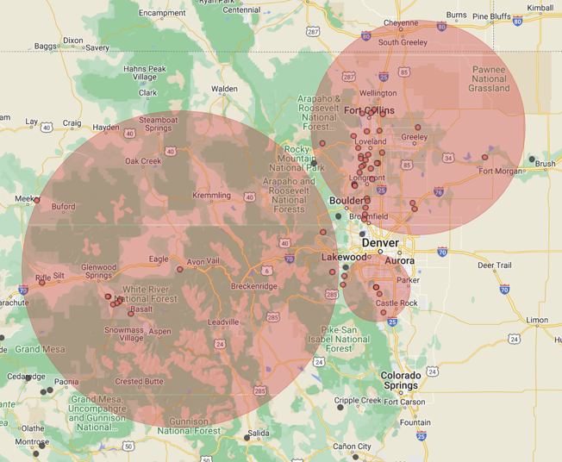
Others –FMD, VSV
FMD: Characterization of reproductive ratio in endemic countries, phylogenetic analysis, spatiotemporal analysis (USDA-ARS, Jonathan Arzt)
VSV: Spatiotemporal analysis of 2019 VSV outbreaks in Colorado using sequencing data (USDA-ARS, Chad Mire, Lauro Velazquez, and John Humphreys)
Preliminary spatiotemporal analysis

Slide 16

Other Research Opportunities
Dominican Republic
Sri Lanka
Bangladesh
China
Uzbekistan
Kazakhstan
Ukraine
Kuwait
Israel
Taiwan
JEV spatiotemporal distribution and analysis, risk assessment, lessons to improve US preparedness
Continue and expand HPAI dashboard
Machine learning and modeling to enhance swine disease surveillance and other ASF/disease control strategies

Slide 17
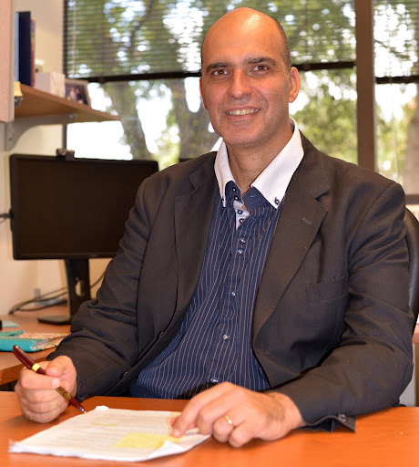

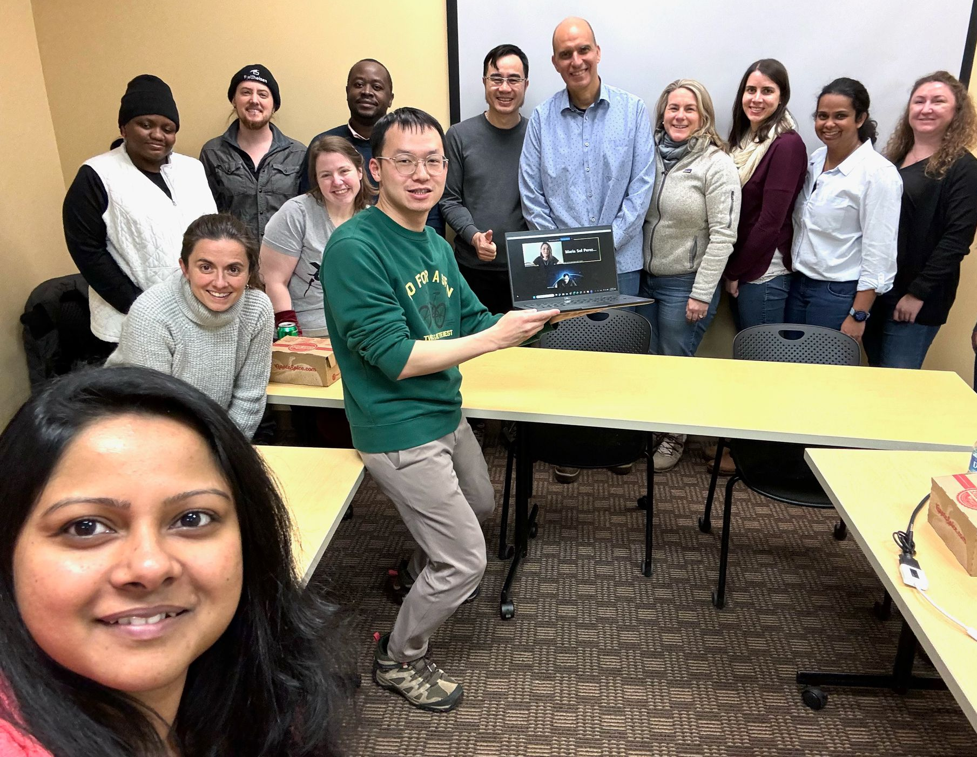


Thank you! Questions?
aperez@umn.edu
Prof. Andres Perez, DVM, PhD
scham083@umn.edu
Rachel Schambow, DVM, PhD
CAHFS Program Leaders
https://cahfs.umn.edu
Andres Perez, DVM, PhD
Professor
Ma. Sol Perez, DVM, PhD
Deputy Director
Mary Katherine O’Brien, PhD
Program Director
Melinda Wilkins, DVM,
MPH, PhD, ACVPM
Residency Director
(most of) The CAHFS Team!

